Slide 1
CPT208 Portfolio Presentation 02 Design to the topic-Interactive Learning System for Chinese History and Culture
Group Number: 15
Group Members:
Yueran Cao 1930115
Yetong Wang 1930253
Lincheng Shi 1927978
Hao-Hsiang Yu 1927488
Qinchuan Zhu 1930549
Notes:
English Title: Uppercase, Calibri size 60, XJTLU Navy
English Subtitle: Uppercase, Calibri size 36, XJTLU Navy

Slide 2

CONTENTS
Target user group
Existing issues and corresponding design alternatives
Design principles
Design theories
Design prototype draft
References
Q&A section
Notes:
Header: Uppercase, Calibri size 28, XJTLU Navy
Body Text: Sentence case, Calibri size 14, Black

Slide 3
Target user group
Domestic students
With more than junior high school education
International students
Interest in Chinese history and culture
Craftsmanship learners
For traditional ceramic craftsmanship
Teachers
Teach history and culture
Notes:
Header: Uppercase, Calibri size 28, XJTLU Navy
Body Text: Sentence case, Calibri size 14, Black

Slide 4
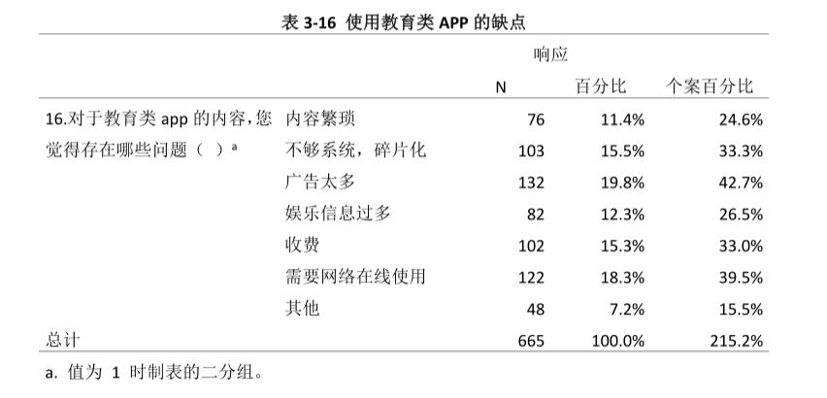
Existing issues and corresponding design alternatives
Domestic student
Problems:
Difficult to remember => complicated and incomprehensible[1]
Browse the information blindly without memorizing the key contents
Solutions and design alternatives:
Q&A system => help remember the focus of the full text
Ranking system => increase the interests
Fig1. The drawback of related apps[1]
Notes:
Header: Uppercase, Calibri size 28, XJTLU Navy
Body Text: Sentence case, Calibri size 14, Black

Slide 5
Existing issues and corresponding design alternatives
International student
Problems:
The translation of relevant knowledge documents and even video explanations
=> still have many controversial issues[2]
Some limited words representing Chinese culture => cause confuse
Solutions and design alternatives:
Intelligent dialogue system
Multi-language learning channels
A comment area forum that can be translated into different languages
Notes:
Header: Uppercase, Calibri size 28, XJTLU Navy
Body Text: Sentence case, Calibri size 14, Black

Slide 6
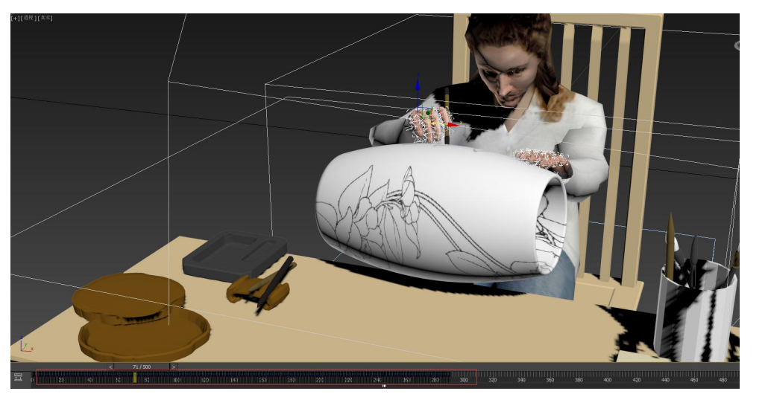

Existing issues and corresponding design alternatives
Craftsmanship learners
Problems:
Observe and understand the details of ceramics only in the form of pictures and videos => difficult
Solutions and design alternatives:
Introduce more vivid learning channels including AR and 3D modelling
Fig2.Example of 3D modelling[3] Fig3.Example of AR
Notes:
Header: Uppercase, Calibri size 28, XJTLU Navy
Body Text: Sentence case, Calibri size 14, Black

Slide 7
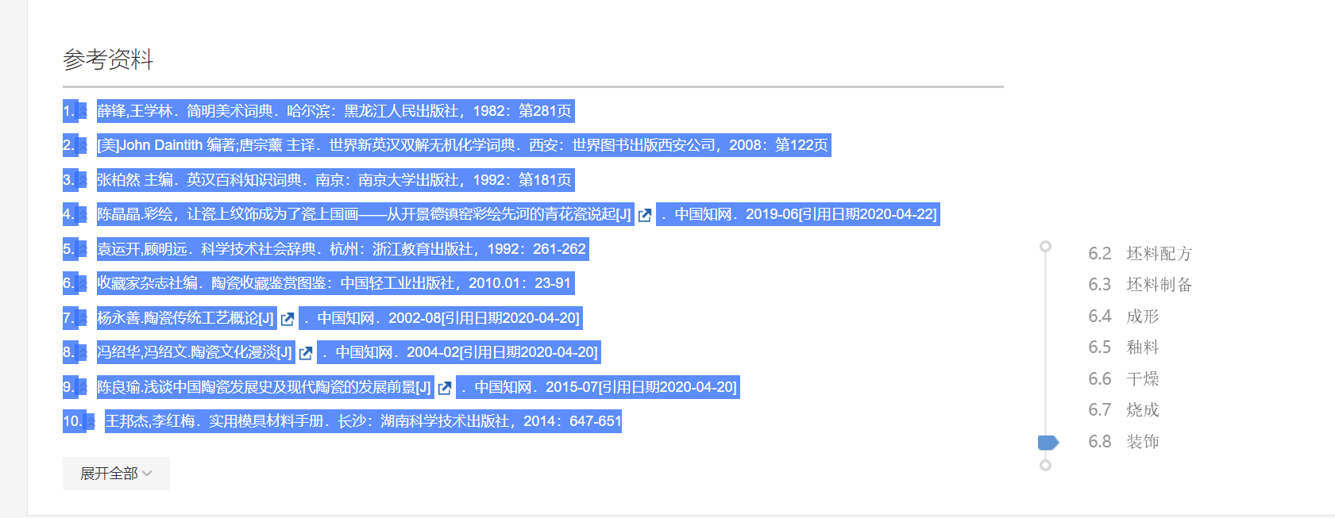
Existing issues and corresponding design alternatives
Teachers
Problems:
Some platforms cannot help them obtain resources well
=> even the content of some resources cannot be efficiently referenced and intercepted
Solutions and design alternatives:
The operating instructions of App are consistent with the mainstream platforms => minimum learning cost
Fig4.Easy to copy and get references
Notes:
Header: Uppercase, Calibri size 28, XJTLU Navy
Body Text: Sentence case, Calibri size 14, Black

Slide 8
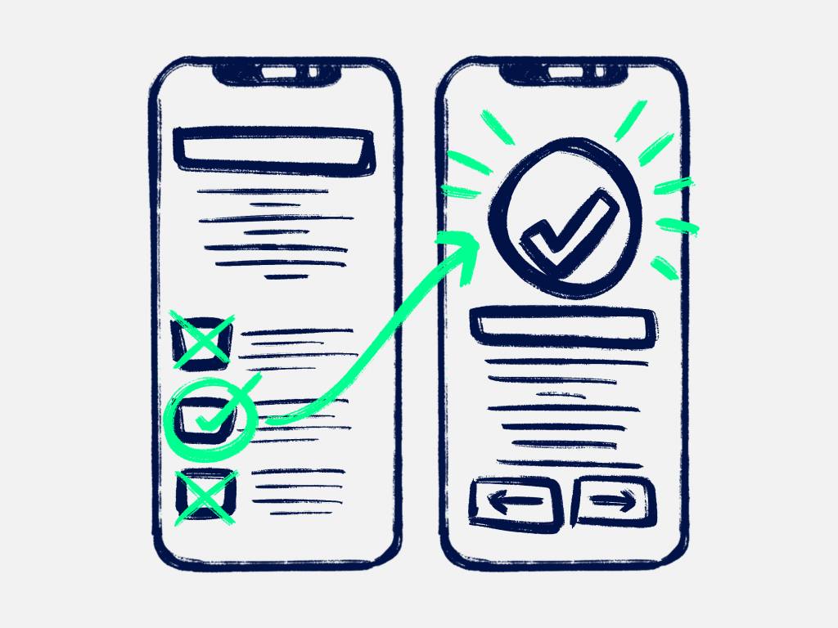
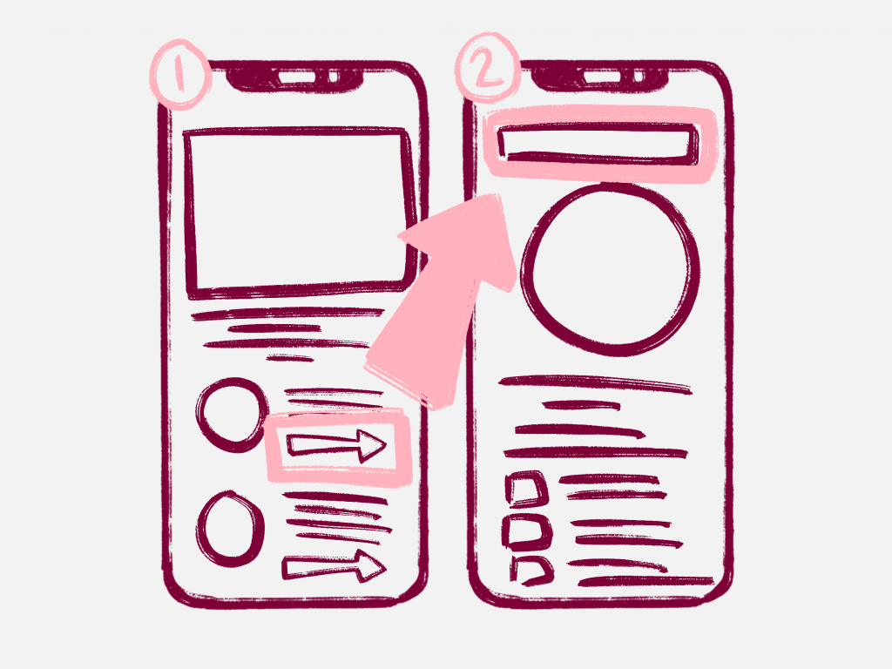
Design principles
Feedback
Interaction word and Visual
Quiz and rank system
Visibility
AR and 3D modeling
Constraint
Quiz system set limitation to focus on content
Learnability, Consistent and Affordance
Cost less and Easy to manage[4]
Fig5.Feedback[4]
Fig6.Learnability[4]
Notes:
Header: Uppercase, Calibri size 28, XJTLU Navy
Body Text: Sentence case, Calibri size 14, Black

Slide 9
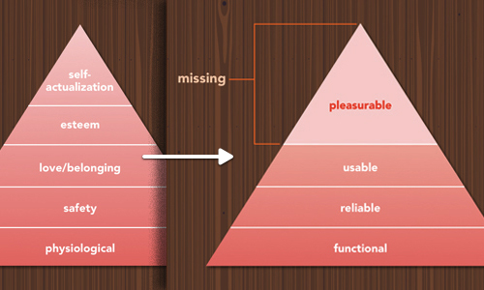
Design theories
Cognitive design
redundancies [5]--------Text and Video
Emotional design
visceral and behavioral [6]-----Interface and Quiz interaction
Fig7. Maslow’s hierarchy of human needs (left) and the hierarchy of emotional design (right)[6].
Notes:
Header: Uppercase, Calibri size 28, XJTLU Navy
Body Text: Sentence case, Calibri size 14, Black

Slide 10
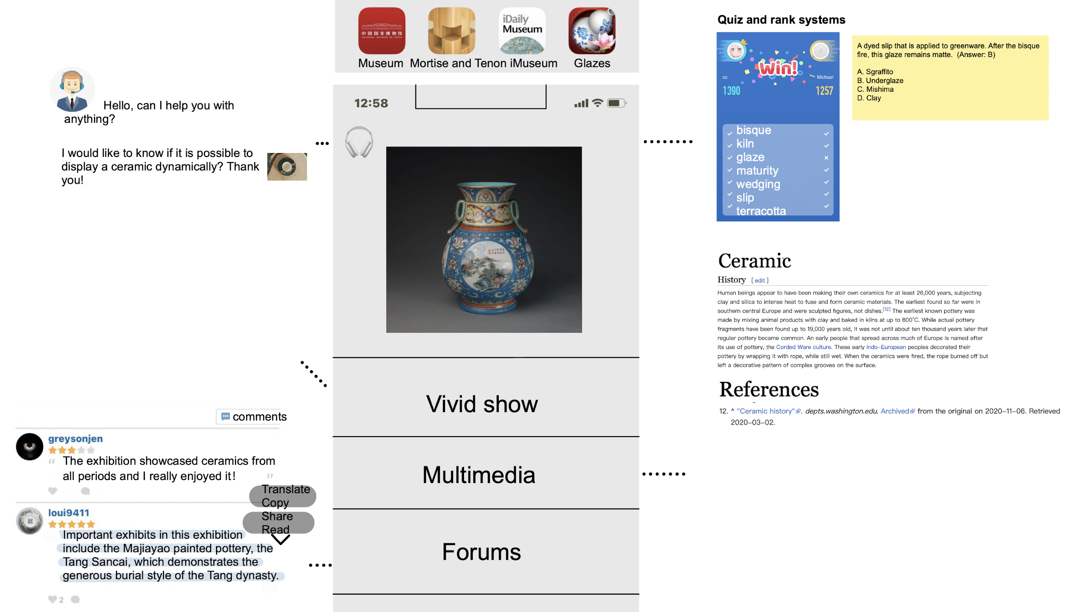
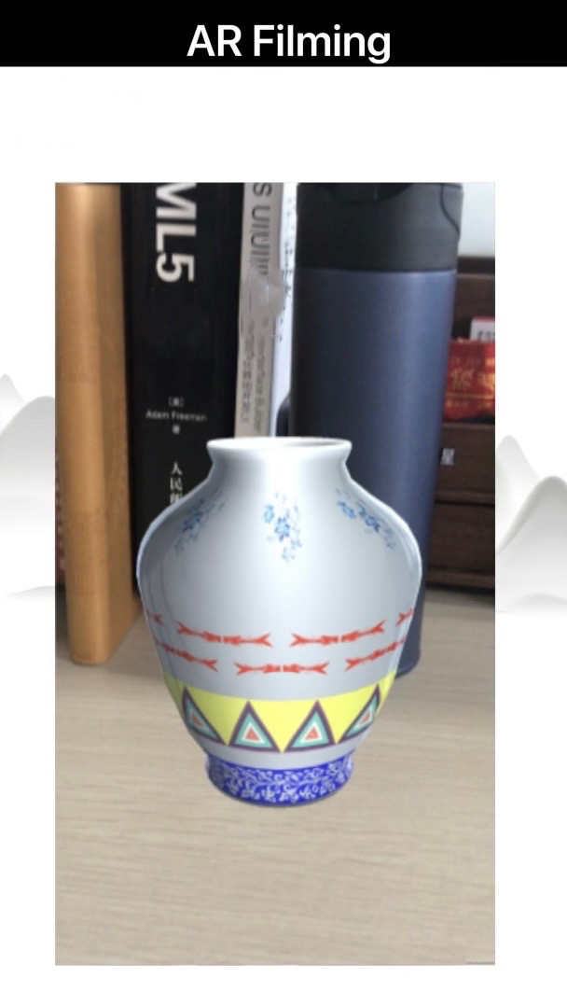
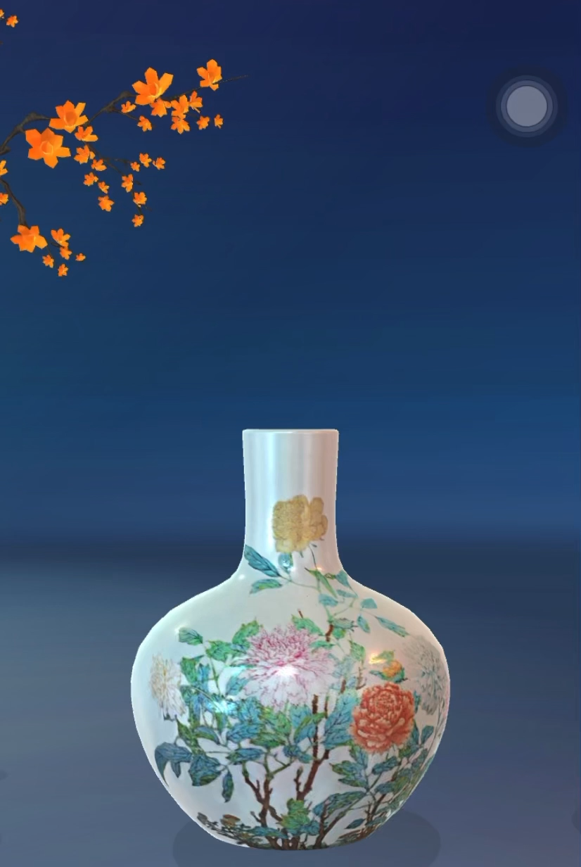
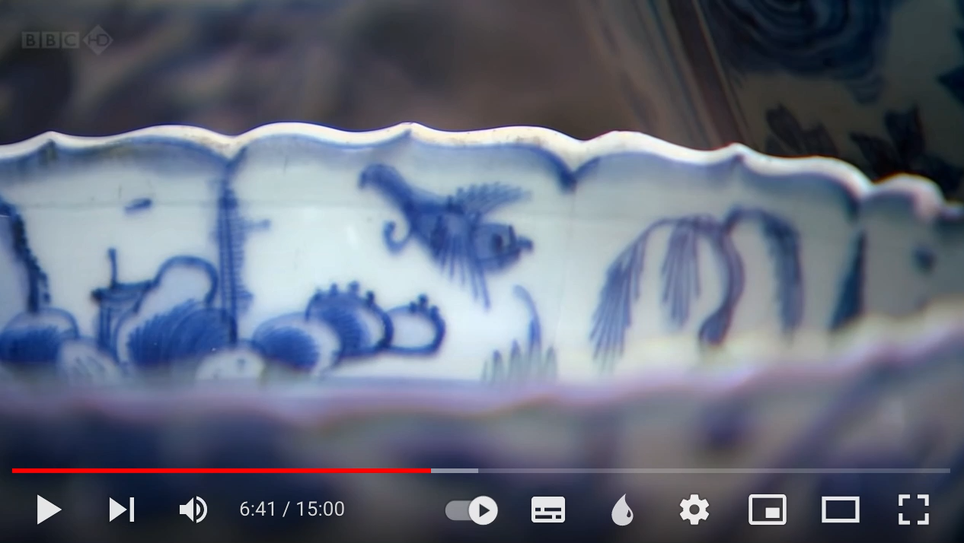

Design Draft
Same operation:
✏️
3D/AR:

Slide 11
References
[1] Zhao Ziyi (2019). Research on the current situation and influencing factors of junior middle school students' use of educational app (Doctoral dissertation, Northeast Normal University)
[2] Li Wenge (2000). Chinese cultural restricted words and their translation (Doctoral dissertation ,Shaanxi Normal University)
[3] Zhang Liming (2019). Digital experience product design of Liling underglaze colorful porcelain process based on AR technology (Doctoral dissertation , Hunan University of Technology)
[4].Griffiths, J., 2021. The 5 principles of user interface design. [online] Created Academy. Available at: <https://www.created.academy/resources/the-5-principles-of-user-interface-design/#:~:text=The%20feedback%20principle%20requires%20designers%20to%20communicate%20whether,guide%20users%20through%20their%20experience%20with%20an%20interface />.
[5].MacLeod, D., 2013. 10 Principles of Cognitive Design. [online] Ergoweb. Available at: <https://ergoweb.com/10-principles-of-cognitive-design/>
[6].Schmid, S., 2012. The Personality Layer. [online] Smashing Magazine. Available at: <https://www.smashingmagazine.com/2012/07/the-personality-layer/>
Notes:
Header: Uppercase, Calibri size 28, XJTLU Navy
Body Text: Sentence case, Calibri size 14, Black

Slide 12
Q&A Section
Notes:
Header: Uppercase, Calibri size 28, XJTLU Navy
Body Text: Sentence case, Calibri size 14, Black

Slide 13
Thank You!
Notes:
Header: Uppercase, Calibri size 28, XJTLU Navy
Body Text: Sentence case, Calibri size 14, Black

